Slide 1
NATIONAL ASSOCIATION OF LARGE FAMILIES
Kinga Joó

Slide 3
NOE in Numbers
- 15.000 member families
- 200 local branches
- cca. 2000 registered volunteers
- more than 3000 types of discounts available with our „large family card”
- 1095 calls/requests for help answered by our hotline service (2019)

Slide 4
Supportive local communities based on active, real, personal relationships.

Slide 5
NOURISHING LOVE PROGRAMME

Slide 6
The most vulnerable members of a society are young families.

Slide 8
FOOD SAVING PROGRAM

Slide 9
NOE in Action
Raising awarness on the importance and vulnerability of large families:
10% of HU families with three or more children
23% of children under 15 live in large families
Fighting for family policy that prevents (rather than tackles) poverty
Recalling that having children should not mean a risk of poverty or social exclusion
Highlighting the special needs of large families in Europe:
13% (8.5 million) of the families with children in Europe have three or more children (2018)

Slide 10
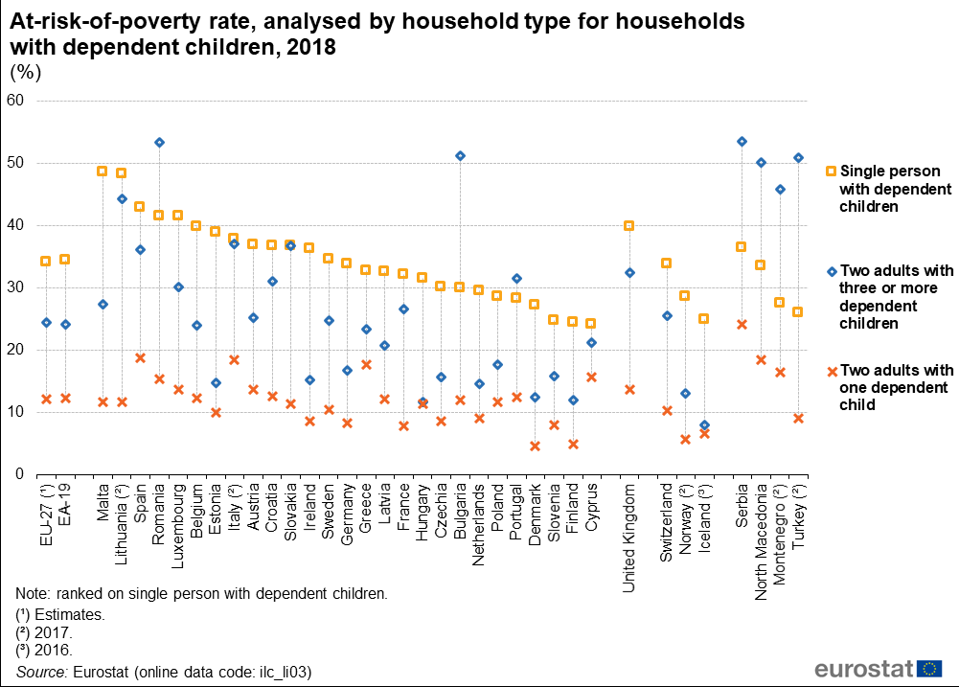

Slide 11
NOE Film

Slide 12
THANK YOU FOR YOUR ATTENTION!
http://noe.hu/en/

