Slide 1
eTwinning: creating an inclusive school
5th October Graz, Austria

Slide 2
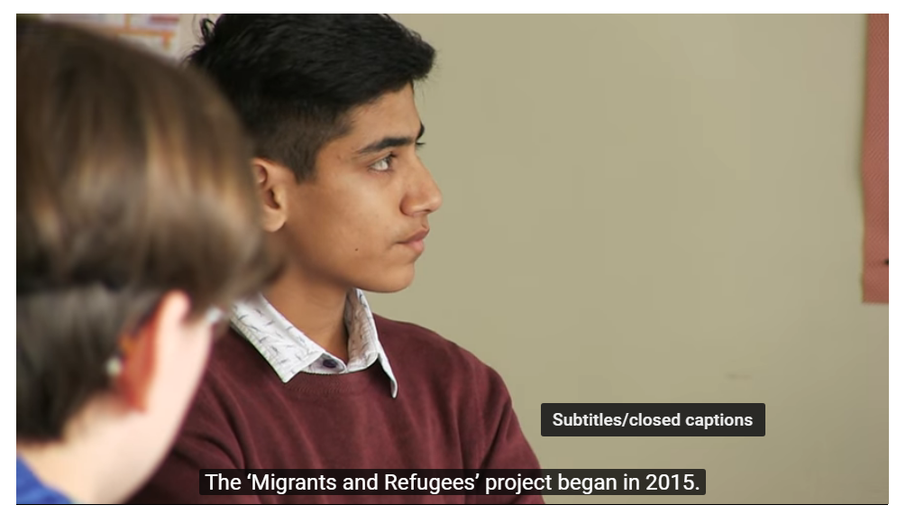
Migrants and refugees
https://www.youtube.com/watch?v=4q3diD6-Px8

Slide 3
What is eTwinning?

Slide 4
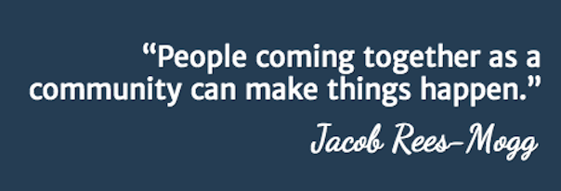
Definition of Community
the condition of sharing or having certain attitudes and interests in common
a similarity or identity
Source: http://oxforddictionaries.com/definition/english/community

Slide 5
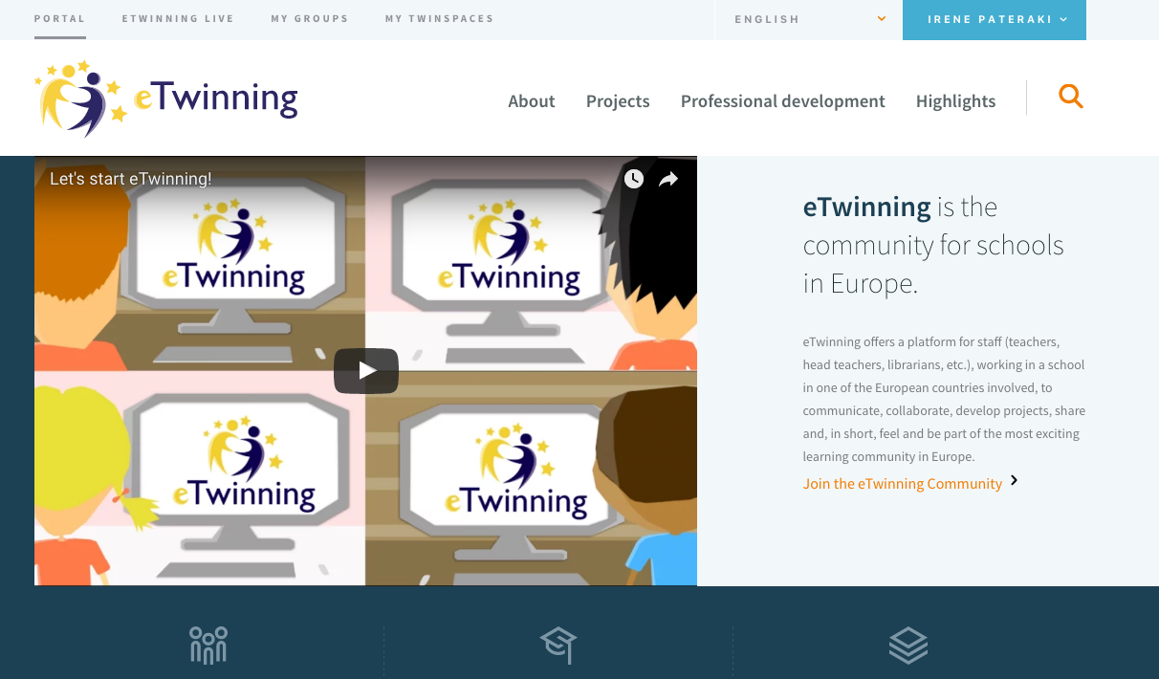
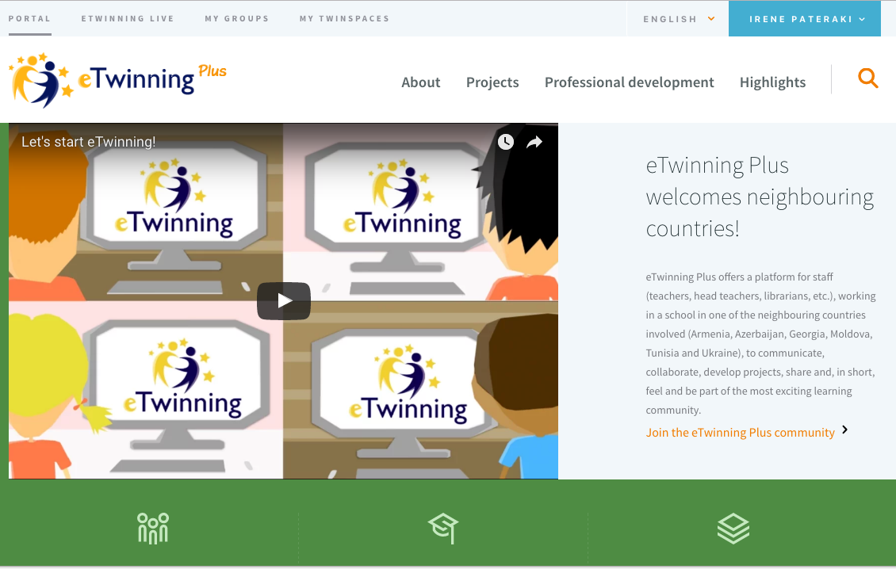
eTwinning and eTwinning Plus
Armenia- Azerbaijan- Georgia
Moldova – Tunisia – Ukraine – Jordan- Lebanon
Notes:
From 46 countries
Online platform

Slide 6

eTwinning is about ….
Collaboration
Professional Development
Innovation
Support
Recognition

Slide 7
Professional Development Opportunities
Online training
Learning Events
Online Professional Development
Groups
Peer Learning
NSS
Face to face training
PDW and other Seminars
Ambassadors Course
Ambassadors
eTwinning Projects
Moderators Course
FCLab courses
Self teaching material
Online Seminars

Slide 8
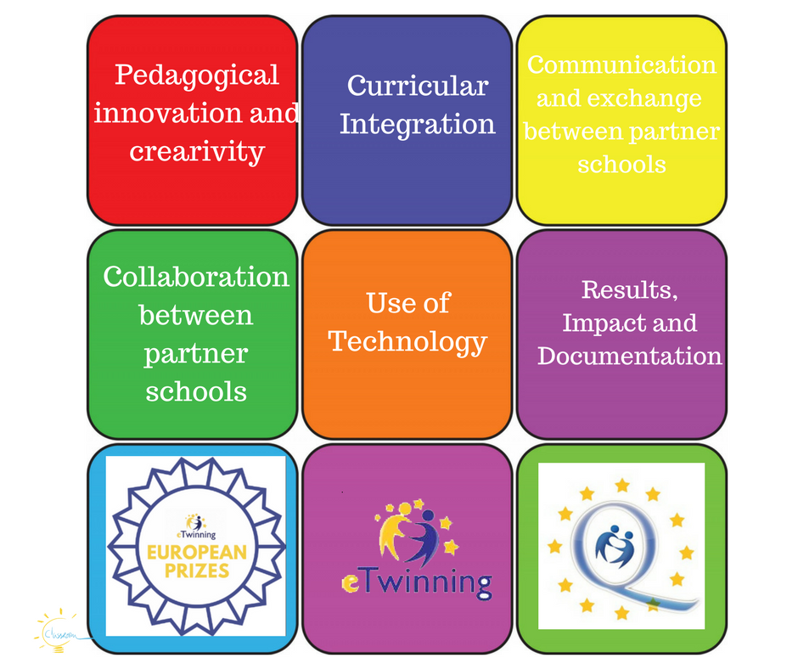
Quality in eTwinning
National – European Quality Labels
National - European Awards

Slide 9
Is it successful?

Slide 10
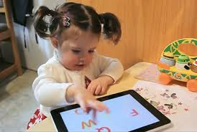
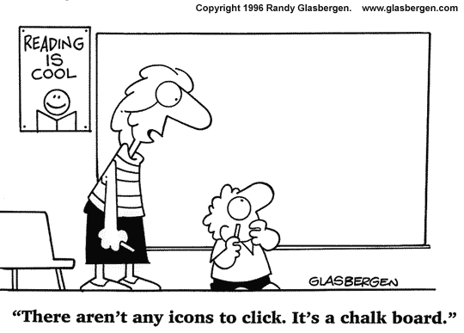
eTwinning= right answer at the right moment

Slide 11
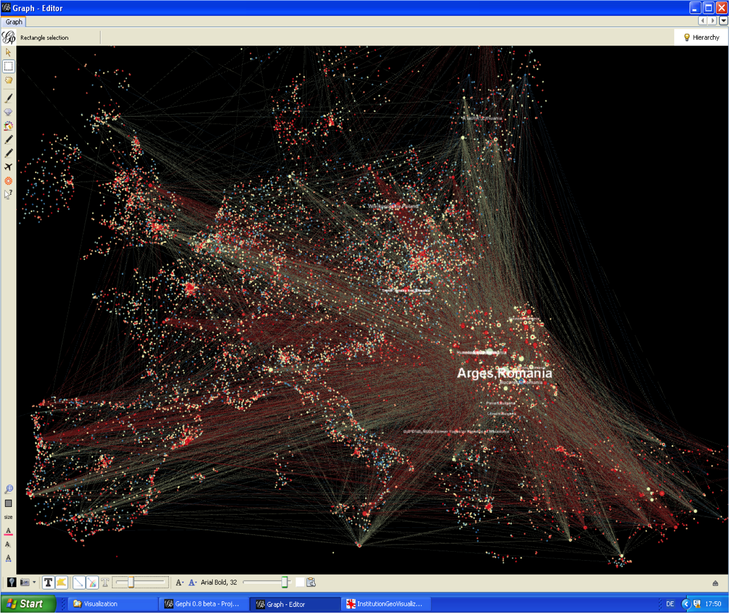
Notes:
2012

Slide 12
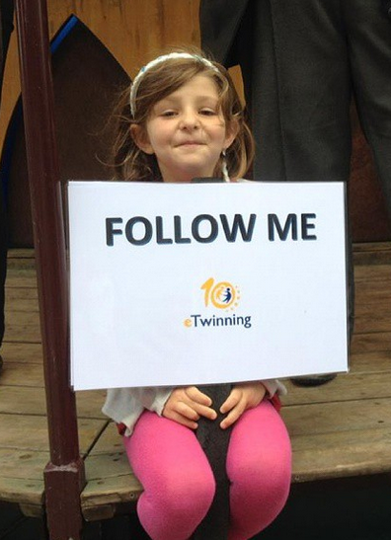
A clear success
590,000+ teachers
195,000+ schools
77,000+ projects
5% teachers registered in the EU
46 countries

Slide 13
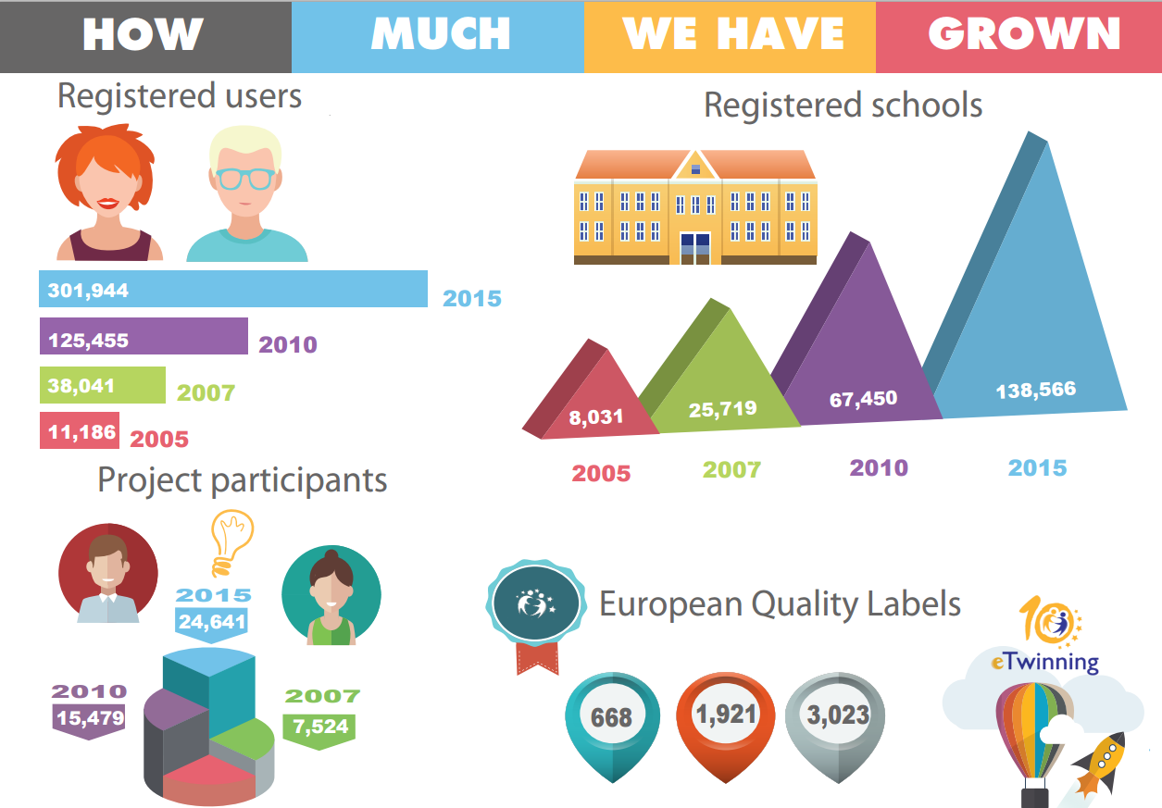

Slide 14
How does it work?

Slide 15
History
2004 – 2007
2008 – 2013
eLearning
Lifelong Learning
2014 - 2020
ERASMUS Plus

Slide 16
European Commission
priorities
Central Support service
coordinate
Ambassadors
promote
National support services
implement
directions
Implement
promote
monitor
motivate
Monitor
analysis
Notes:
Governance of eTwinning

Slide 17
How do we work with national network?
meetings
trainings
means
methods
support
Notes:
Online and onsite meetings
Training on site online
Means: community digest
Sub groups innovation and collaboration
Support both sides

Slide 18





Teacher at the core
Notes:
Feedback
Suggestions
Support
Disseminate
Education at the core

Slide 19
Do you have evidence?

Slide 20
Monitoring Report 2017
This survey of 5,900 eTwinners illustrates that eTwinning has a significant impact on the development of individual teachers’ skills and teaching practices, as well as on student’s motivation and learning practices. It confirms that eTwinning is an important tool to promote innovation in schools.
Notes:
http://files.eun.org/etwinning/2017/etwinning%20summary%20report/etwinning%20summary%20report%202017/eTwinning-summary-report_final_web.pdf.pdf

Slide 21
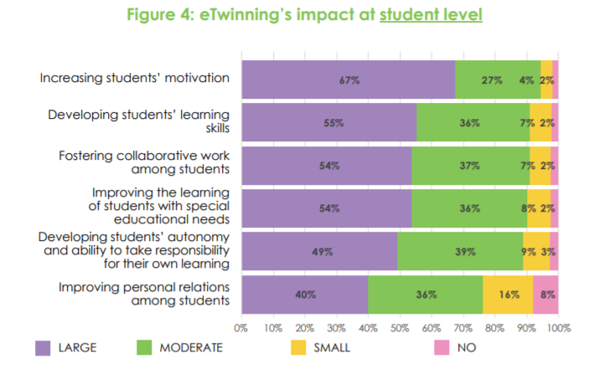

Slide 22
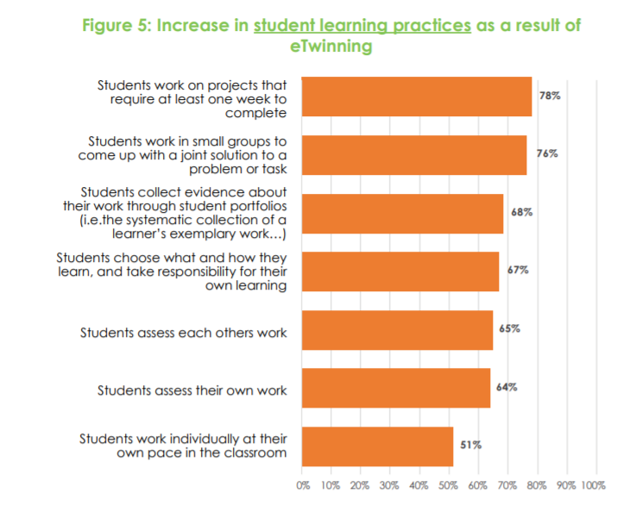

Slide 23
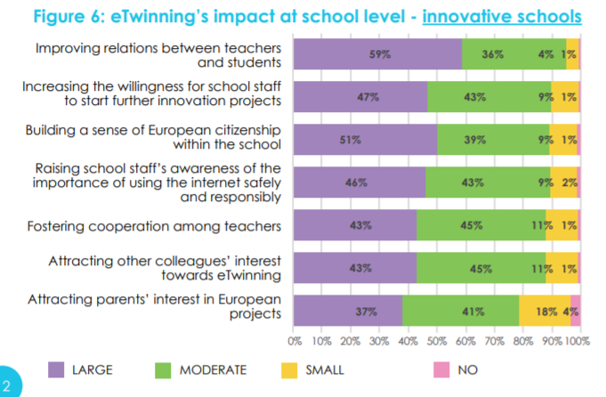

Slide 24
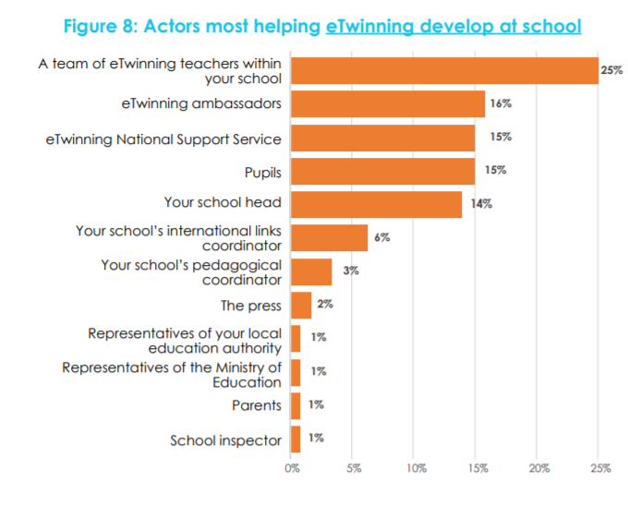

Slide 25

Room for improvement?

Slide 26
What about future?

Slide 27

Notes:
eTw addresses teachers, in the future we would like adopt a school approach as well as local community
Consolidate the basis the ground

Slide 28
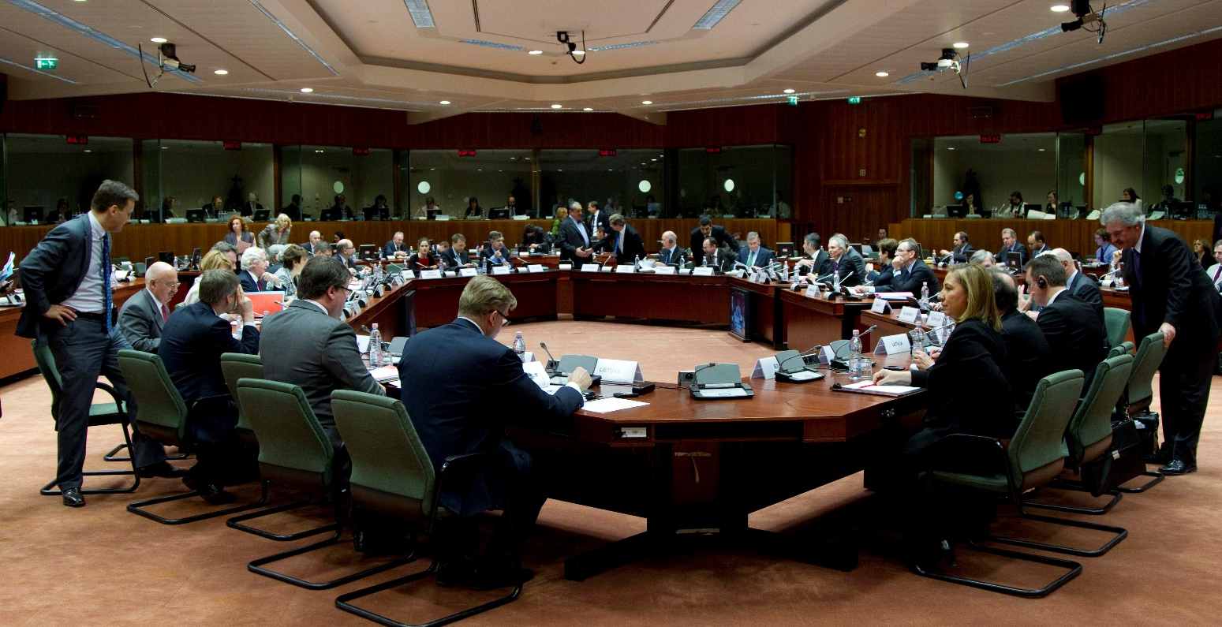
Notes:
Work with MoE 3 last years good progression established regular meetings with them to explore how we can support their work and how eTw can be embedded in school education

Slide 29


Slide 30


Slide 31
Is eTwinning inclusive?

Slide 32
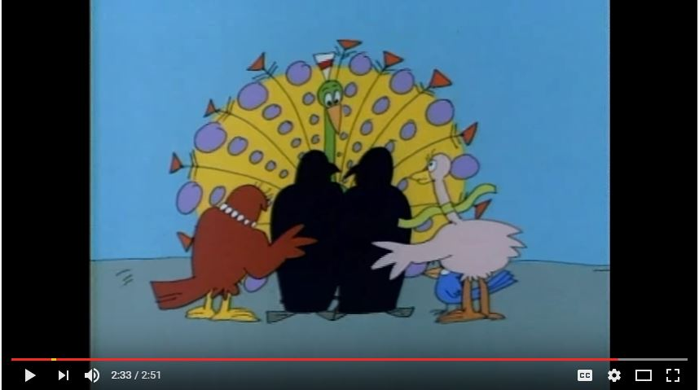
A Peacock in the Land of Penguins
https://www.youtube.com/watch?v=hNeR4bBUj68
Notes:
Do we speak about the same thing?

Slide 33
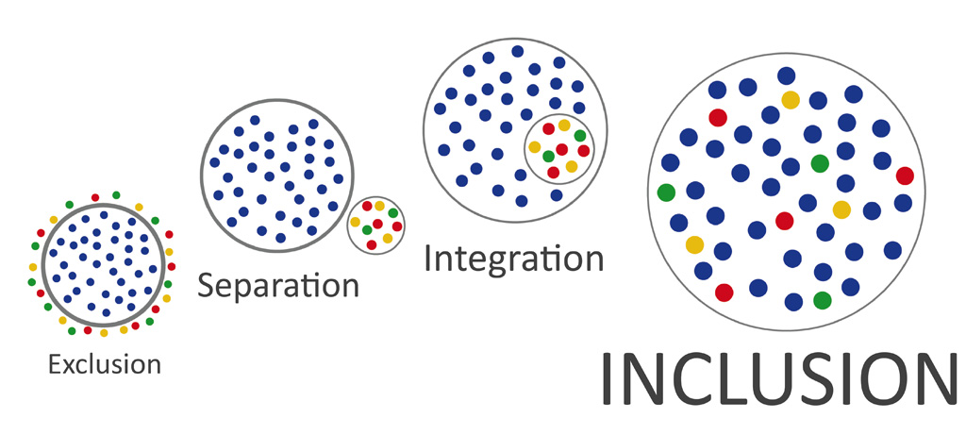
Inclusion: the idea that everyone should be able to use the same facilities, take part in the same activities and enjoy the same experiences, including people who have a disability or other disadvantages.
Every learner matters and matters equally.
(Unesco, 2017)

Slide 34
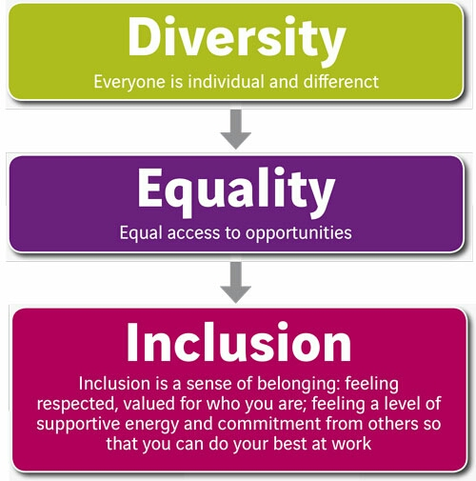

Slide 35
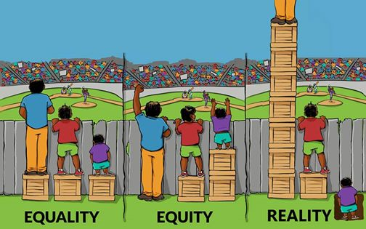

Slide 36

Inclusion projects
Disability
Health problems
Educational difficulties
Cultural differences
Economic obstacles
Social obstacles
Geographical obstacles

Slide 37
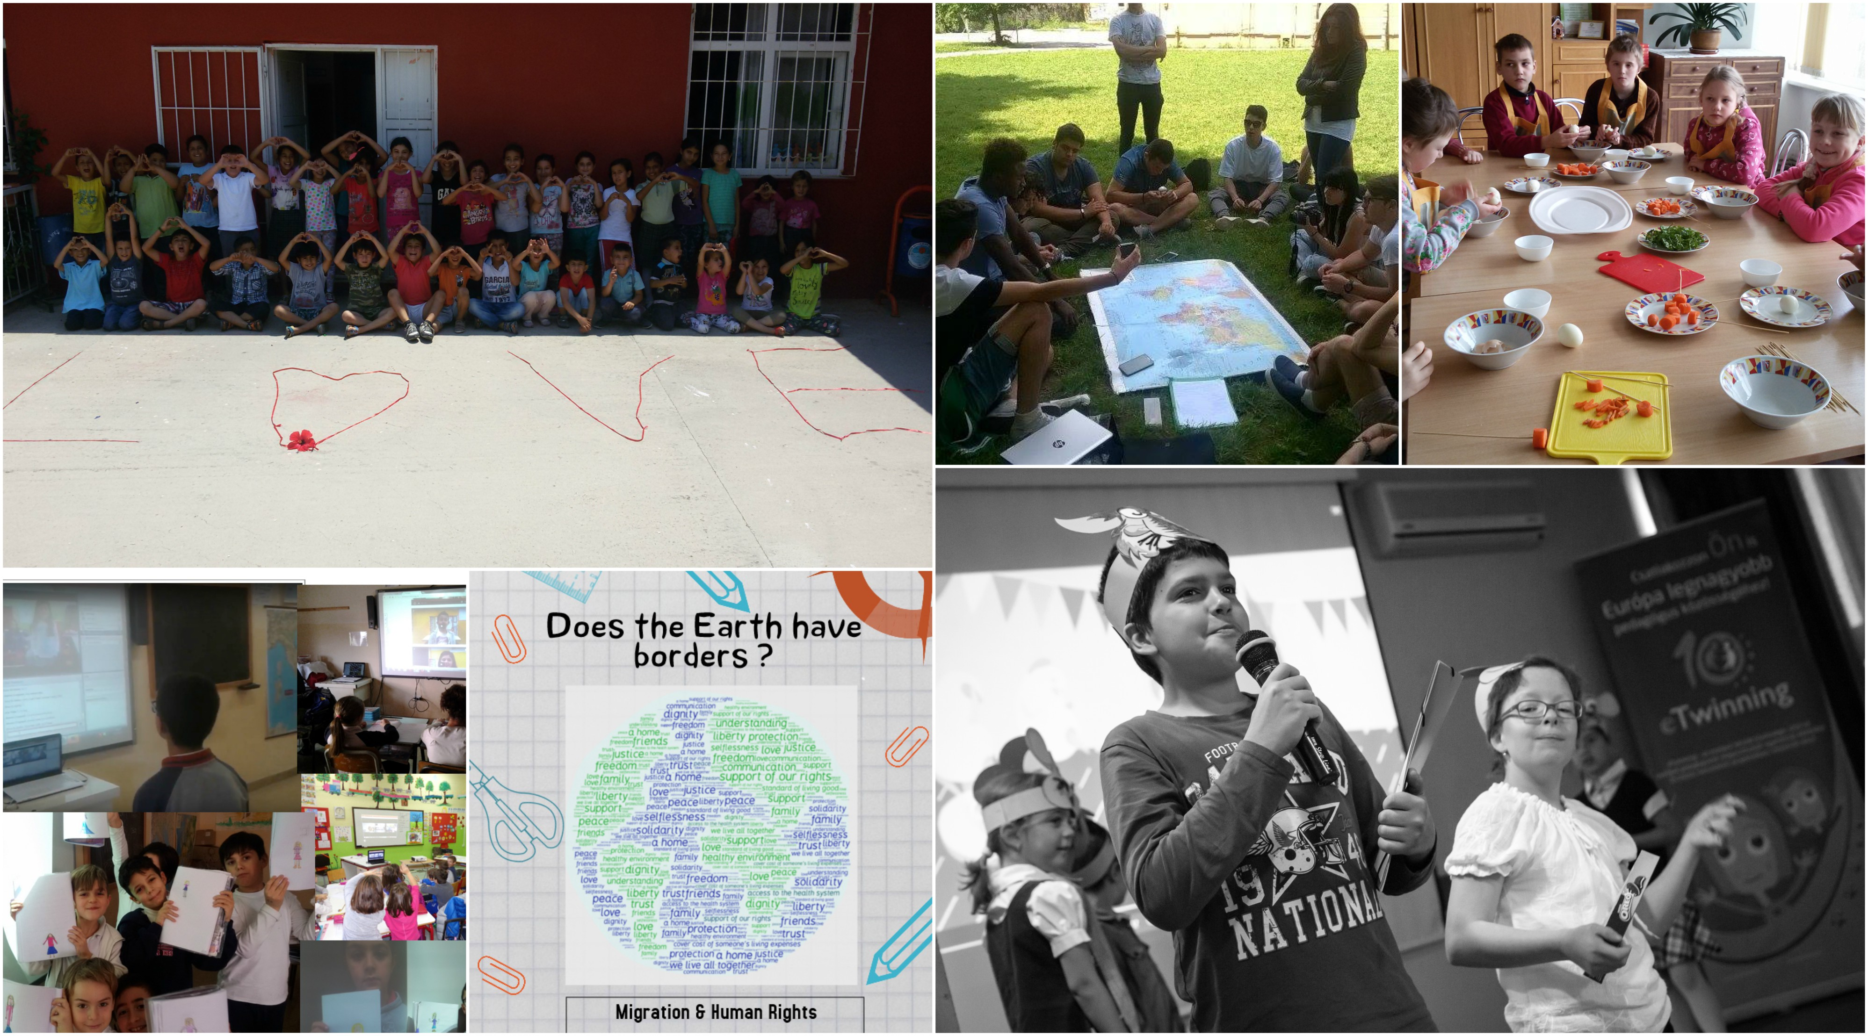

Slide 38
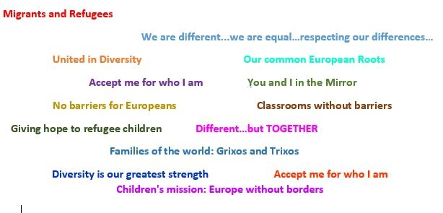
Since 2005, teachers who work in eTwinning projects have had as their main aim to desire: to widen the horizons of their pupils open for them a window to Europe through activities that promote the understanding of inclusion, the development of common values and a positive response to diversity.

Slide 39


eTwinning and Inclusion
Spring Campaign: The prism of Inclusion
2 PDWs on the topic of inclusion in 2017
Featured Groups:
Inclusive Education
Gender-know-how to stop stereotypes
Integrating Migrant Students at School
Online Seminars
Learning Events
eTwinning weeks
European Conference

Slide 40
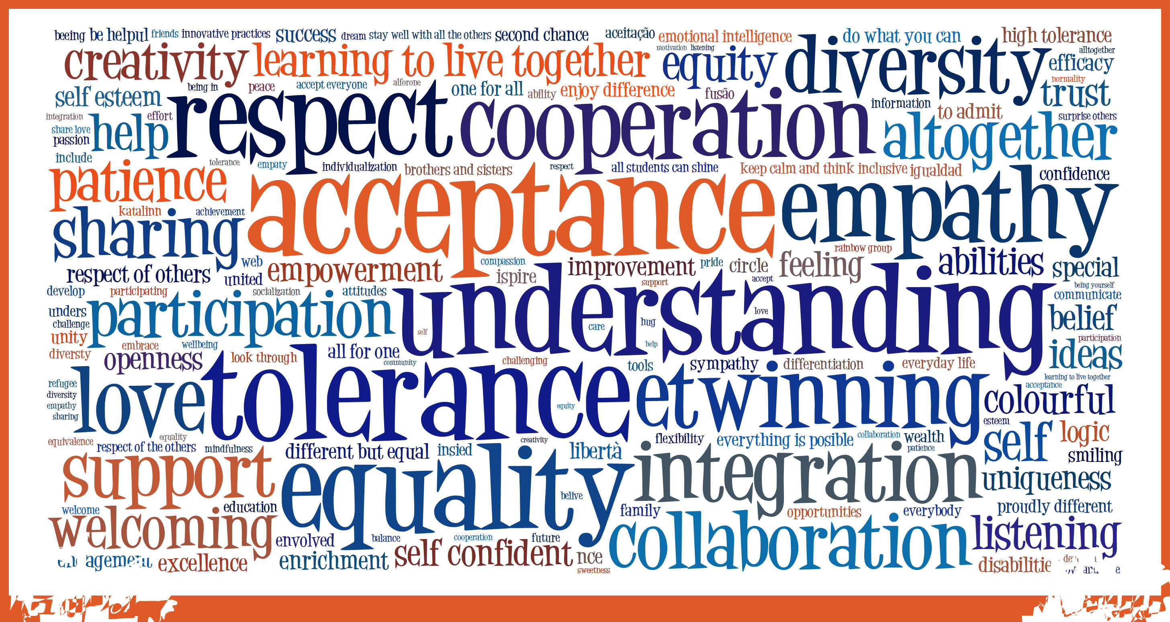

Slide 41
The meaning of eTwinning is revealed in the experiences of the magical trips that is offering us, through the use of ICT technologies, even in the more remote areas of Europe. That’s how the students’ community widens; the knowledge, the culture, the tradition, the experience, the desire, the expression, transform into Art and Speech for the Virtue and they root in the most unexpected places, to the archetype of harmony in nature, that the Greeks called Kosmos. (Aikaterini Tziri, head teacher, Greece)
My class has been in many projects with the same school in Europe. I feel as if they are a part of my class.
(Jón ,10, Iceland)
French Guiana is an ultra-marine French region located in South America and therefore one of the outermost region of European control. eTwinning is the window to Europe and offers my students the opportunity to meet virtually with peers and collaborate in educational projects. It is an excellent opportunity to broaden their horizons and develop their European citizenship and sense of belonging to Europe. (Sandra Macabre, teacher, France)
In our classroom, there are pupils from 13 different nations. We are a great example of how to get along with each other despite different cultural, linguistic and religious backgrounds. We focus on what we have in common; we appreciate the individual backgrounds and learn from each other. (Kristina Gugerbauer , teacer, Austria)
My family and I ran from the Syrian war and we came to Turkey 4 years ago. Being a part of this project made us feel important and valued. I could barely understand a few words in Turkish and now I can easily communicate.(Zehra,11, Turkey)
Working with eTwinning is the perfect way to improve the skills of my students who come from underprivileged backgrounds and different origins and thanks to this project, each one was able to collaborate actively at their own pace through a reflection on the theme of European Immigration.(Murièle Dejaune, teacher, France)
I really enjoyed receiving all these postcards. I did not know eTwinning before. I was surprised to see so many letters. It was a very amusing birthday. I loved being with my colleagues and teachers celebrating this very important day. (Rebeca, 14, Portugal)

Slide 42

eTwinning weeks
#eTwinclusion

Slide 43
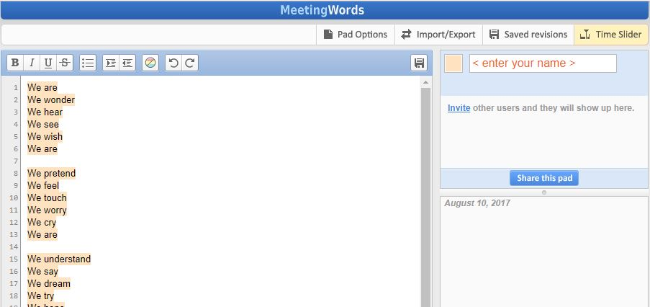
Having that in mind…
"I Am" (or "Lines: I Am") is a poem written by English poet John Clare in late 1844 or 1845 and published in 1848
Let’s write our “We are poem…” having in mind Inclusion
http://meetingwords.com/HZ5560urE2

Slide 44
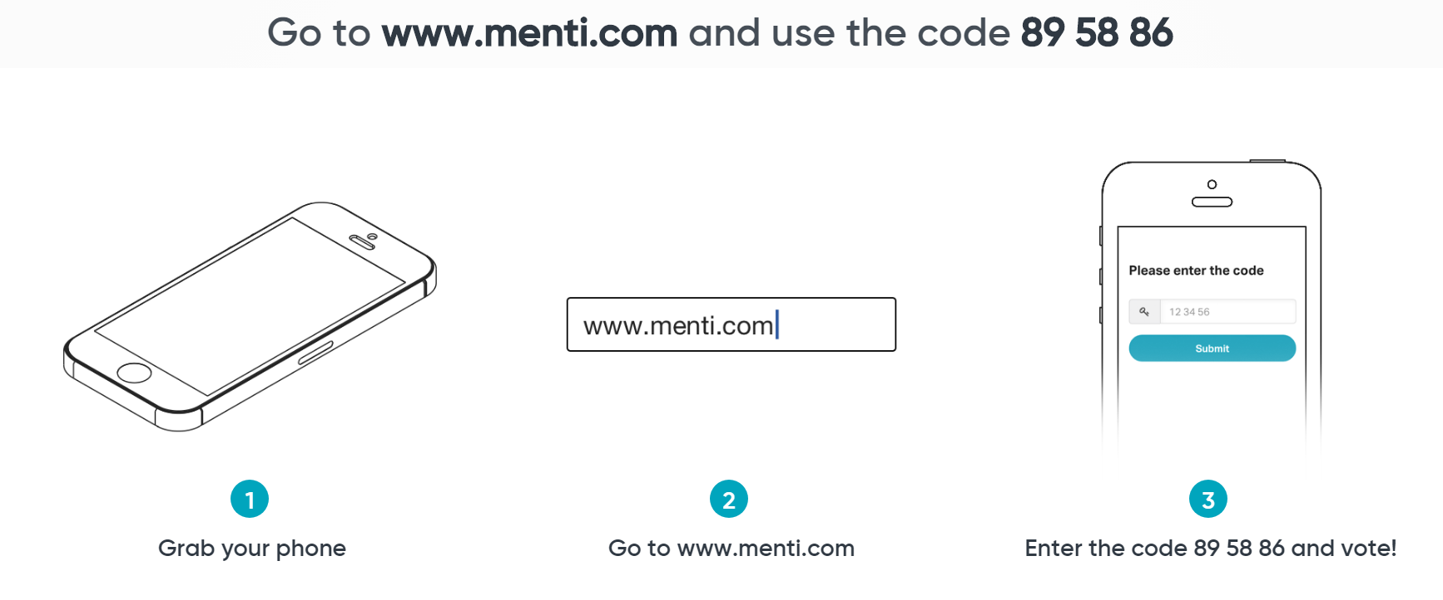
How to better support?

Slide 45
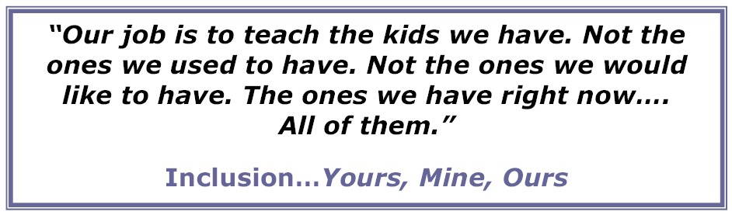

Notes:
Kevin Maxwell

Slide 46
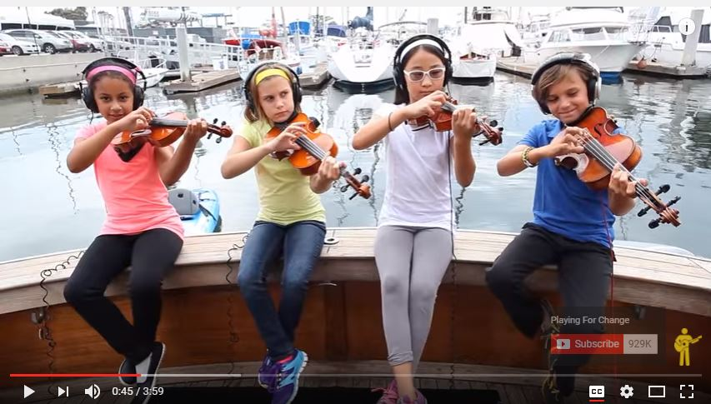
https://www.youtube.com/watch?v=uWXUWepSak4

Slide 47
Thank you for your attention!
Claire.Morvan@eun.org

